Slide 1

Interpersonal Communication and Counseling
Presented by
Dr. Soad H. Abd El Hamid El Tantawy
Lecturer of Gerontological Nursing
Faculty of Nursing
Mansoura University
Notes:
Dr. Soad Hassan

Slide 2
Outlines
Introduction
Definition of communication, Interpersonal communication, counseling
Elements of communication
Types of communications
Communication process
Characteristics of effective communication
Knowledge and skills needed for effective interpersonal communication
Characteristics of effective counseling
Barriers to effective communication Tools for effective counseling
Application of IPC in health care
Methods and Approaches to IPC

Slide 3
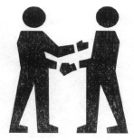
What is Communication?
Communication can be defined as the process by which people share ideas, experience, knowledge and feelings through the transmission of symbolic messages.
The means of communication are usually spoken or written words, pictures or symbols. But we also give information through body language, gestures, and looks, facial expressions can show how we feel and what we think about an issue or another person.

Slide 4
What are the most common ways
we communicate?
Visual Images
Spoken Word
Written Word
Body Language

Slide 5
Types of Communication
Downwards Communication : Highly Directive, from Senior to subordinates, to assign duties, give instructions, to inform to offer feed back, approval to highlight problems etc.
Upwards Communications : It is non directive in nature from down below, to give feedback, to inform about progress/problems, seeking approvals.
Lateral or Horizontal Communication: Among colleagues, peers at same level for information level for information sharing for coordination, to save time.

Slide 6
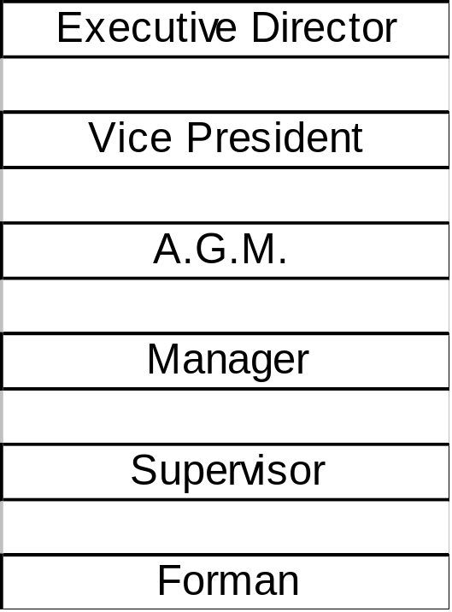
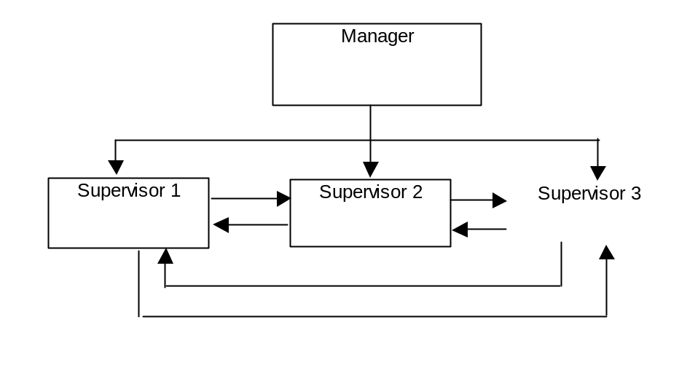
HIERARCHY LEVEL
Downward Comm.
Upward Comm.
Horizontal Comm.

Slide 7
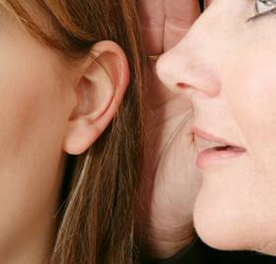
Communication Key Elements
Message
Source (sender)
Channel
Receiver
Filter
Feedback

Slide 8
The Communication Process
Medium
Barrier
SENDER
(encodes)
Barrier
RECEIVER
(decodes)
Feedback/Response

Slide 9
Characteristics of effective communications
Effective communication requires the message to be:
Clear and concise
Accurate
Relevant to the needs of the receiver
Timely
Meaningful
Applicable to the situation

Slide 10
Characteristics of effective communications
Effective communication requires the sender to:
Know the subject well
Be interested in the subject
Know the audience members and establish a rapport with them
Speak at the level of the receiver
Choose an appropriate communication channel

Slide 11
Characteristics of effective communications
The channel should be:
Appropriate
Affordable
Appealing

Slide 12
Characteristics of effective communications
The receiver should:
Be aware, interested, and willing to accept the message
Listen attentively
Understand the value of the message
Provide feedback

Slide 13
Characteristics of effective communicator
An effective verbal communicator:
Clarifies
Listens
Encourages empathically
Acknowledges
Restates/repeats
An effective nonverbal communicator:
Relaxes
Opens up
Leans toward the other person
Establishes eye contact
Shows appropriate facial expressions

Slide 14
Interpersonal Communication (IPC)
Interpersonal communication is a person to person, two-way, verbal and non verbal interaction that includes the sharing of information and feelings between individuals or in small groups that establish trusting relationships.
IPC in health care settings takes place between service providers and their clients and members of the community and is a key element in maximizing access to quality care. IPC includes the process of education, motivation and counseling and starts with understanding the critical role of good client service.

Slide 15
Education is the process of providing factual information and clarification about a topic to an individual or group.
Counseling is the act of helping a client to make her or his own decision, by providing unbiased information and asking questions about what the client wants and what the client thinks that he or she can do.

Slide 16
Counseling is a special process. It is a confidential dialogue between a medical provider and a client that helps a client to define his or her feelings and to cope with stress. Usually people need training to be a good counselor.
Counseling is different from education, although education can be an important part of counseling. Counseling is NOT solving the client’s problem for him or her or giving advice. In the counseling process, the medical provider avoids taking on the client’s problem or telling him or her how to solve the problem or what decision or action to take.

Slide 17
Knowledge and skills needed for effective interpersonal communication
Adequate knowledge of subject area
An understanding of one's own values and willingness to withhold judgment about the other people’s values.
Skills in verbal and nonverbal communication.
Ability to show empathy and encourage others.
Skills in asking questions and listening.
Tolerance and patience
Ability to paraphrase and summarize the concerns of individuals and the community.
Ability to observe and interpret behavior of other people.
Ability to use language that other people understand.
Skills to effectively use support materials.
Confidence
Flexibility

Slide 18
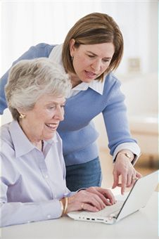
Characteristics of effective counseling
Client-centered
Interactive
Private and confident
Individualized

Slide 19


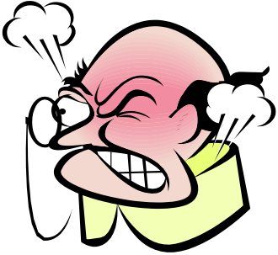

Barriers to communication
Language
Values and beliefs
Sex/gender and age
Economic status
Educational level
Physical barriers
Attitude
Timing
Understanding of message
Trust

Slide 20
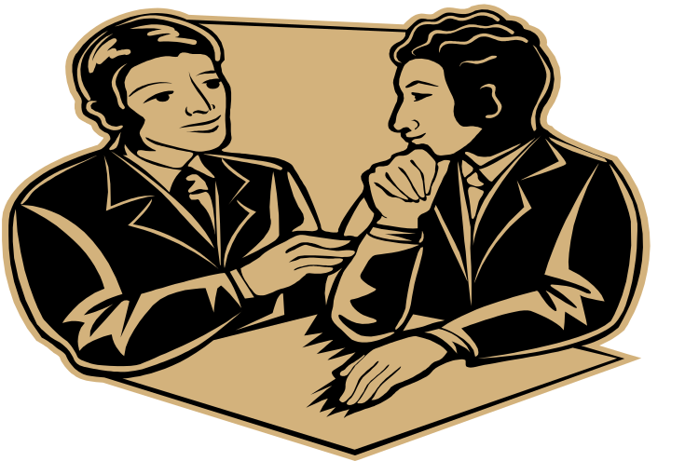
Tools for effective counseling
Communication skills.
Technical information.
Understanding the stages of the counseling process.

Slide 21
Good interpersonal communication skills include treating clients with respect, asking clear questions, and helping them feel more comfortable talking about their needs.
A provider needs to have technical knowledge about their area of expertise. A provider needs to understand the steps involved in counseling.

Slide 22
Application of IPC in health care
1- History taking: Each intervention begins with a thorough analysis of the existing situation in a given field.
2- Channeling: The objective of channeling is to motivate community to utilize the preventive and curative health services offered.
This is carried out through one-to-one communication and group education sessions.

Slide 23
3- Counseling: The objectives of counseling are:
  To share information about the disease and treatment options
  To promote compliance through negotiation with the client over positive treatment and behavior changes.
  To help clients make informed decisions
4- Dialogue with Patients/clients: the objective of dialogue is to:
  Determine what services are needed by the clients and what the best way to provide those services is.
  Management of diseases, conditions and rehabilitation of patients and clients when they go to health institutions.

Slide 24
5- Overall Socio-Emotional Communication:
The objectives of effective socio-emotional communication are:
To establish and maintain a positive rapport with the patient throughout the encounter.
To enhance patients to open up and comply. Socio-emotional skills include the ability to use statements to show empathy, concern, positive regards, and to give reassurance.

Slide 25
Methods and Approaches to IPC
Identify trained personnel
Training of service providers in different departments
Media groups
Pro-approach
Advocacy and community mobilization
Organizational mobilization

Slide 26
Interpersonal communication can be in the form of lecture, role play, group discussion, drama, meetings, counseling.
In addition, visual aids, such as posters, charts, flyers, pamphlets, and audio visual aids such as, video, films, radio, taped messages. These can be used to reinforce IPC.

Slide 27
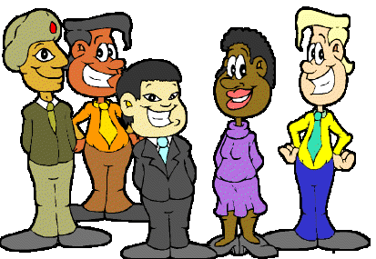
Success for YOU…
…in the new global and diverse workplace requires
excellent communication skills!

Slide 28

Questions

